Slide 1





CounselDesk
AI-Powered Legal Services Platform

Slide 2

Project Phase - II Presentation
Presented By
Name | Roll No. | Class
Sushil Gupta | 1/22/FET/BCS/132 | 7CSE C1
Sankit Singhal | 1/22/FET/BCS/148 | 7CSE C1
Aayush Kukreja | 1/22/FET/BCS/159 | 7CSE C1
Rahul Kumar Mandal | 23/SET/CS(L)/010 | 7CSE C2
Under the Guidance of
Dr. Pronika Chawla
Associate Professor

Slide 3
TABLE OF CONTENTS
Introduction
Overview
Problem Statement & Objective
Proposed Solution
System Architecture
User Experience
The Client Experience (User)
The Professional Experience (Lawyer)
The AI-Powered Core
Technology & Architecture Deep Dive
The Technology Stack
Data Model
API Request Flow
Core Workflow Analysis
Appointment Booking
Stripe Payment Flow
Deployment & Project Management
CI/CD Pipeline
Automation: Cron Jobs
Conclusion & Future Scope
Conclusion
Future Scope
References
Live Demo & Links

Slide 4



01
Introduction

Slide 5
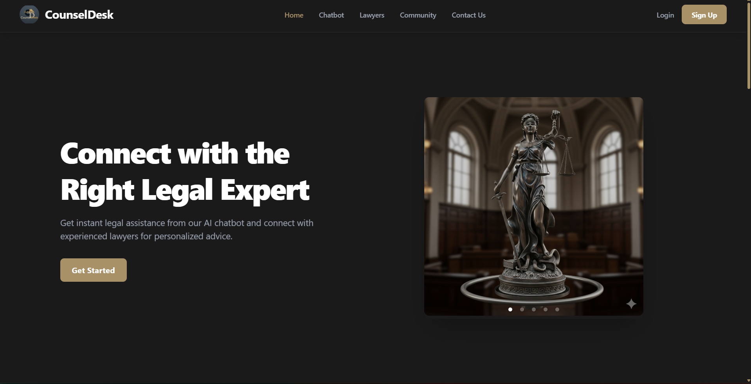
Overview
CounselDesk is an AI-powered legal services platform designed to streamline interactions between clients and legal professionals. It provides a unified ecosystem where users can discover verified lawyers, book appointments, make secure payments, and attend live video consultations, while lawyers manage their entire digital practice through dedicated dashboards.
The platform integrates advanced technologies such as Google Gemini AI, Stripe, Jitsi Meet, and Cloudinary, delivering a modern, scalable, and automated solution for legal assistance. Built as a full-stack monorepo, CounselDesk aims to bridge accessibility gaps in legal services through a seamless, user-centric digital experience.

Slide 6
Problem Statement & Objective
Problem Statement
Objectives
Access to legal services is fragmented, slow, and often confusing for users.
Clients struggle to find verified lawyers who match their needs, budget, and availability.
Traditional legal consultation methods lack convenience, transparency, and digital support.
Lawyers do not have a unified platform for scheduling, document handling, payments, and client management.
To develop a centralized digital platform that connects clients with verified legal professionals.
To provide seamless features such as lawyer discovery, appointment booking, secure Stripe-based payments, and Jitsi video consultations.
To integrate AI-powered legal assistance using Google Gemini for code search and text summarization.
To offer separate dashboards for Users, Lawyers, and Admins, ensuring role-based access control and smooth workflow.
To enhance accessibility, reliability, and efficiency of legal services through a modern full-stack web solution.

Slide 7
Proposed Solution
CounselDesk offers a unified, AI-powered legal services platform that simplifies interactions between clients and legal professionals through the following key solutions:
Centralized Legal Ecosystem
A single platform where users can find verified lawyers, book consultations, view legal codes, and receive AI-generated insights.
Smart Lawyer Discovery
Advanced filtering, specialization search, ratings, and availability-based selection to help clients find the right lawyer instantly.
Secure Video Consultations
Embedded Jitsi Meet for live, one-on-one lawyer–client consultation sessions.
AI-Driven Legal Assistance
Google Gemini–powered tools for:
Legal text summarization
Code exploration
Context-aware legal help
Dedicated Dashboards for All Roles
Role-based interfaces for:
Users (booking & consultation management)
Lawyers (scheduling, earnings, verification)
Admins (analytics, verification, platform oversight)
Automated Operational Workflows
Vercel Cron Jobs handle:
Daily slot regeneration
Appointment status updates
Backend maintenance tasks

Slide 8
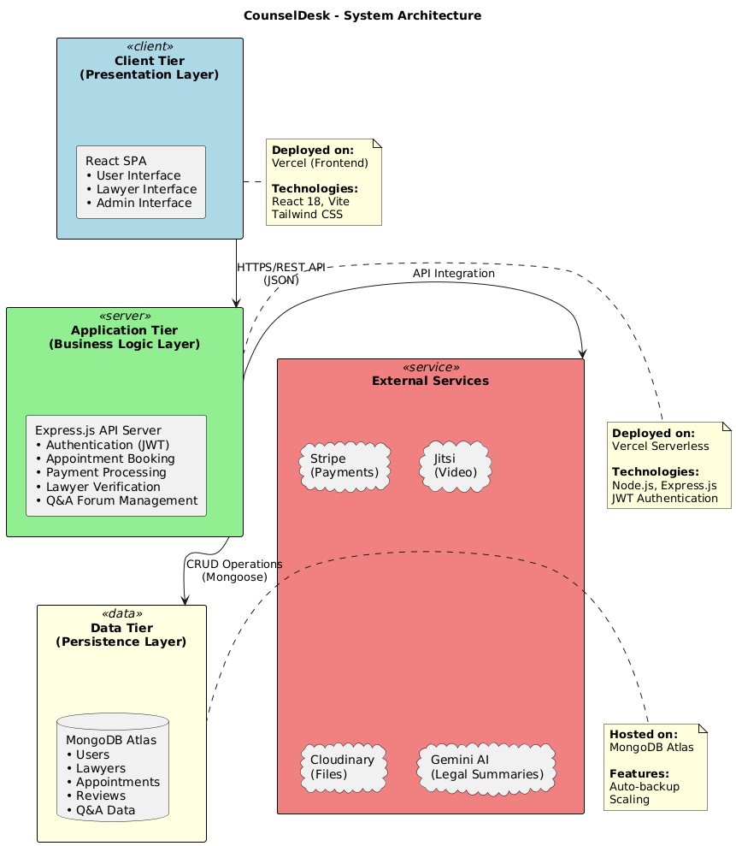
System Architecture
1. Client Tier (Frontend)
React SPA for Users, Lawyers & Admins
Built with React 18, Vite, Tailwind CSS
Hosted on Vercel
2. Application Tier (Backend)
Node.js + Express.js server
Handles authentication, bookings, payments, video links, Q&A, AI tools
Deployed as Vercel Serverless APIs
3. Data Tier
MongoDB Atlas (Mongoose)
Stores Users, Lawyers, Appointments, Reviews & Q&A data
4. External Services
Stripe: Payments & Lawyer Payouts
Jitsi: Secure Video Meetings
Cloudinary: File & Document Storage
Gemini AI: Legal Summaries & Code Search

Slide 9

02
User Experience

Slide 10
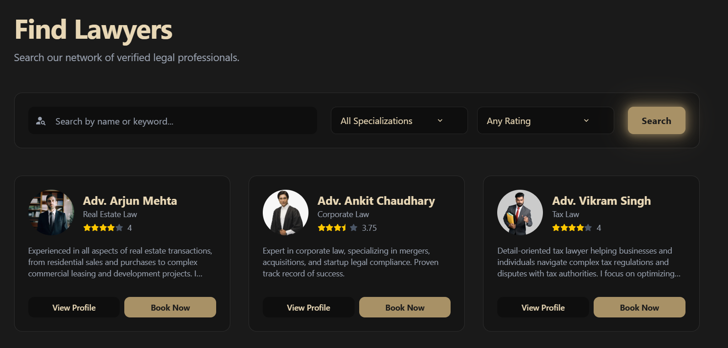
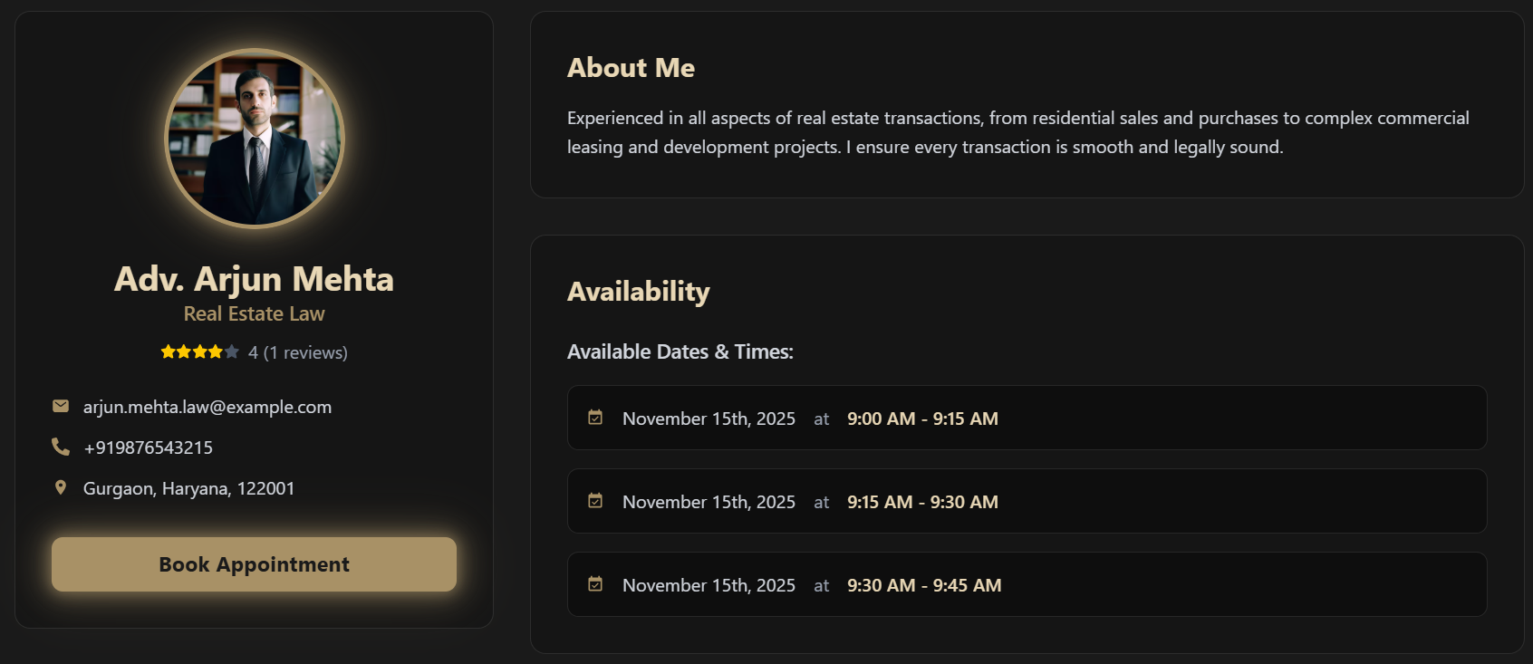
The Client Experience (User)
1. Discover Lawyers Easily
Users can search and filter lawyers by specialization and rating.
Smart search and pagination help users find the right lawyer quickly.
2. View Detailed Lawyer Profiles
Users can explore complete lawyer information:
Bio & Specialization
Experience & Availability
Ratings & Reviews
Consultation Fees
Users can proceed directly to booking a time slot from the profile.

Slide 11
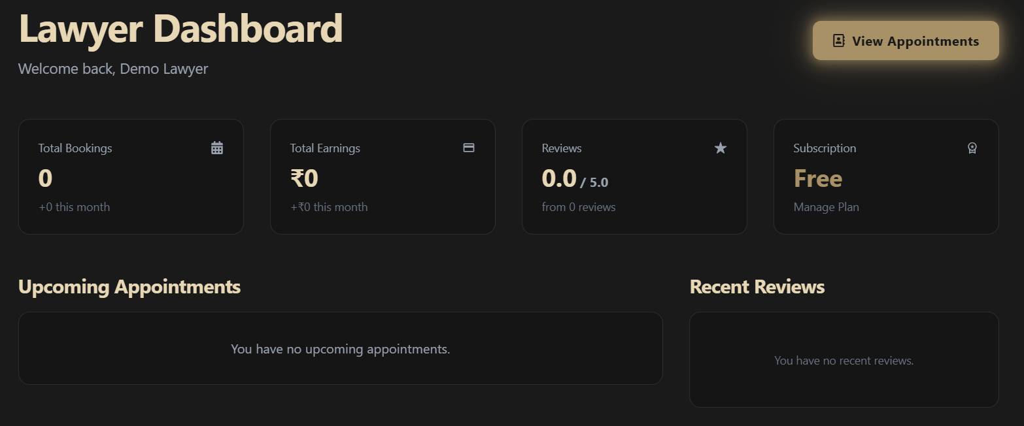
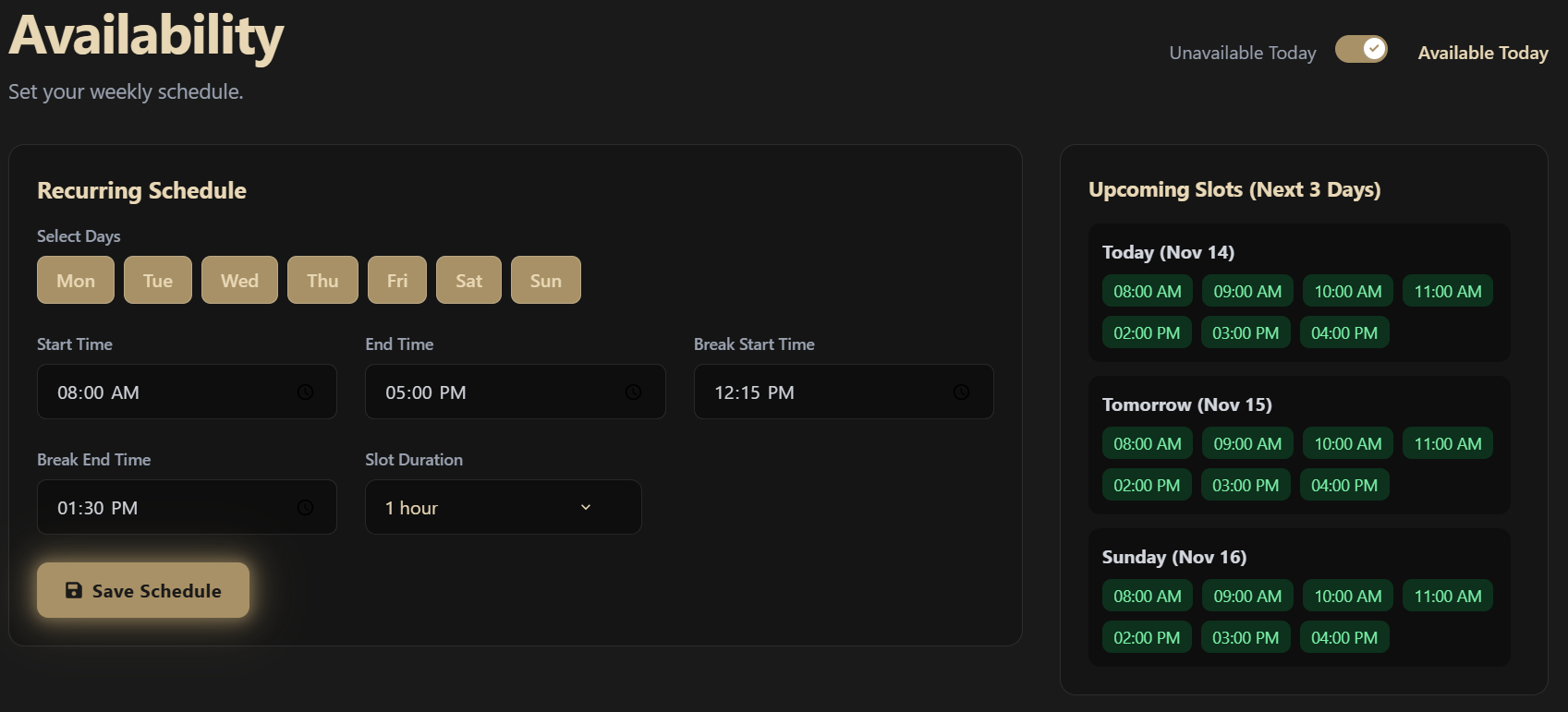
The Professional Experience (Lawyer)
1. Centralized Lawyer Dashboard
Provides a quick snapshot of earnings, upcoming appointments and reviews.
Helps lawyers track their performance and manage consultations easily.
2. Manage Availability & Scheduling
Lawyers can set their weekly availability using an intuitive schedule interface.
Slots generated automatically for users to book based on availability.
Ensures fully controlled and flexible time management.

Slide 12
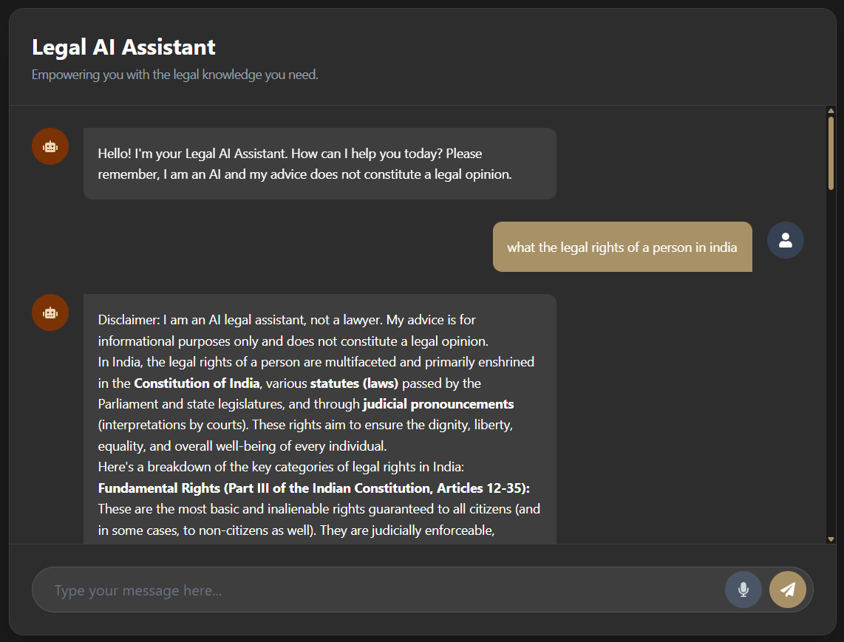
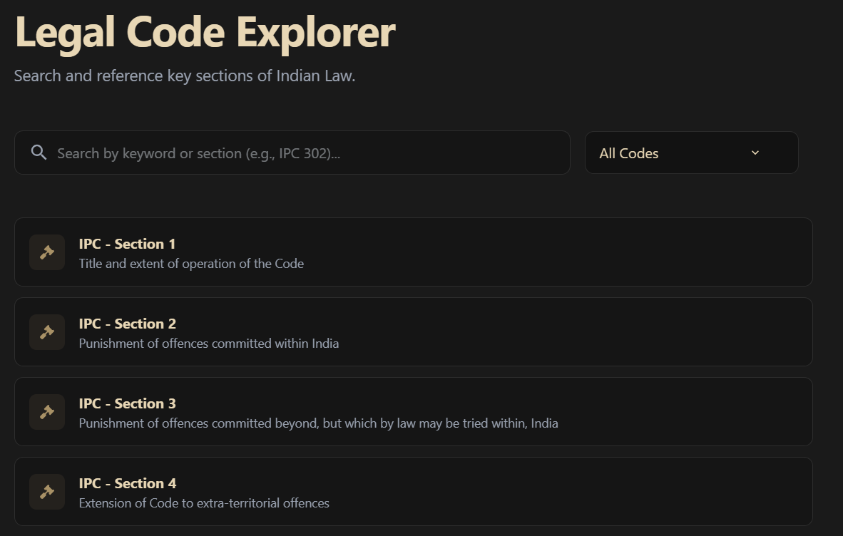
The AI-Powered Core
1. Smart Legal Assistance (Chatbot)
The built-in AI chatbot helps users instantly interpret legal concepts.
Provides summaries, explanations, and context-aware guidance using Google Gemini.
Enhances accessibility by simplifying complex legal text.
2. Legal Code Explorer
Users can search, browse, and understand Indian legal codes with AI-generated summaries.
Provides quick, accurate interpretations of long legal documents.
Helps clients get clarity before consulting a lawyer.

Slide 13
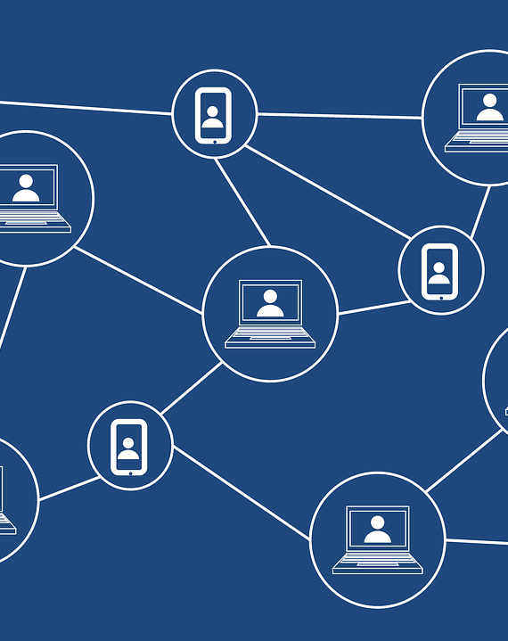
03
Technology & Architecture Deep Dive

Slide 14
The Technology Stack
Category | Technologies | Purpose / Description
Frontend | React 18 | Core UI framework for building the SPA.
 | Vite | Fast development server and build tool.
 | Tailwind CSS | Utility-first styling for responsive UI.
 | React Query | Handles data fetching, caching, and server state sync.
Backend | Node.js | JavaScript runtime for server-side logic.
 | Express.js | REST API framework powering application routes.
 | MongoDB Atlas | Cloud database storing users, lawyers, appointments, etc.
 | JWT Auth | Secure authentication using access & refresh tokens.

Slide 15
The Technology Stack
Category | Technologies | Purpose / Description
Services & DevOps | Stripe | Handles payments, appointments checkout, and lawyer payouts via Stripe Connect.
 | Cloudinary | Secure storage for documents, profile photos, and uploads.
 | Jitsi Meet | Live video conferencing for lawyer-client consultations.
 | Google Gemini | AI summarization and legal assistance (Code Explorer, chatbot).
 | Vercel | Hosting for frontend & serverless backend, CI/CD & cron jobs.

Slide 16
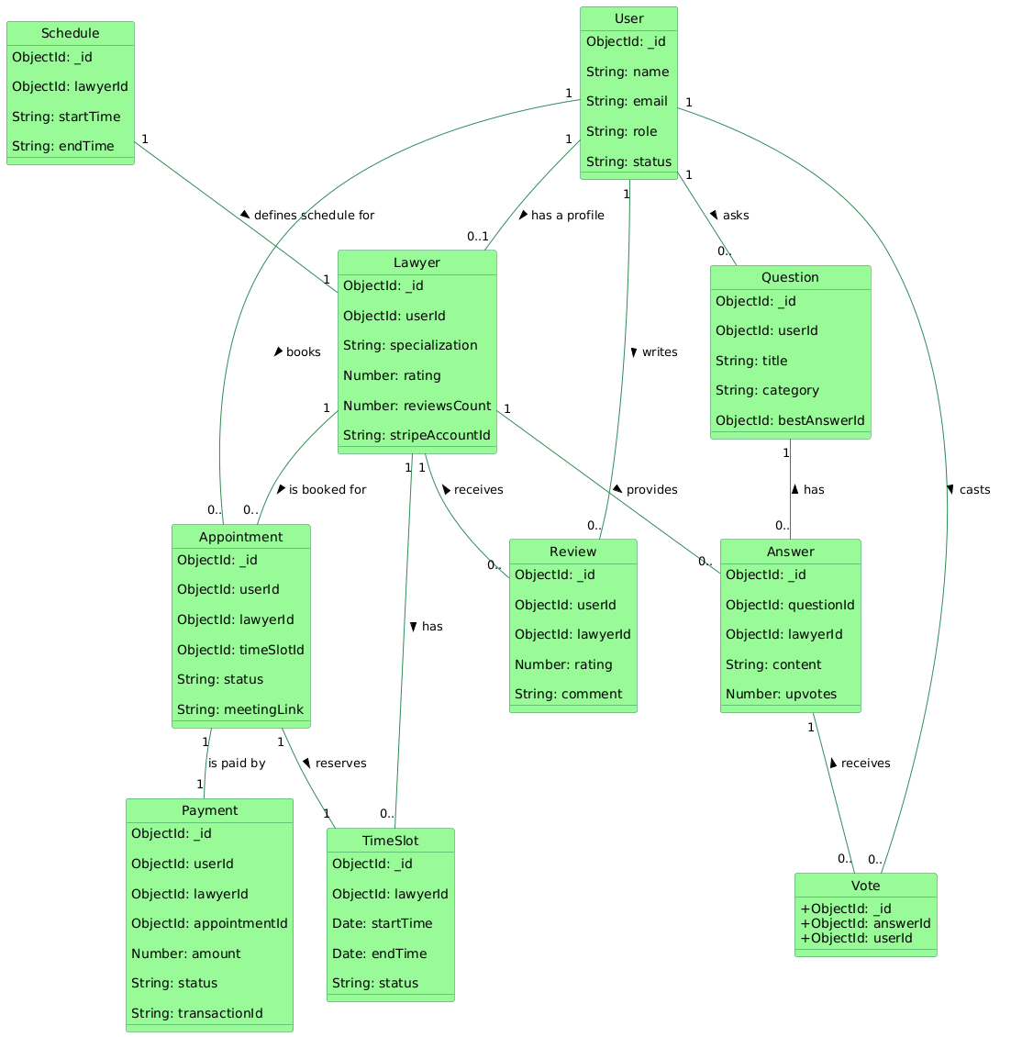
Data Model
User
Stores user details: name, email, role, status
Can book appointments, ask questions, write reviews, and vote on answers
Lawyer
Extends a user with specialization, ratings, stripeAccountId, and verification
Has schedules, available timeslots, appointments, and reviews received
Appointment
Connects a user, lawyer, and a timeSlot
Stores meeting link, status, and booking info
Each appointment is tied to a payment
Payment
Tracks payments made by users for appointments
Includes amount, stripe transaction ID, and payment status

Slide 17
Data Model
Time Slot & Schedule
Lawyers define availability using Schedule
System generates Time Slots automatically
Users can reserve slots which become appointment records
Question & Answer
Users post questions
Lawyers provide answers
Every question can have one best answer
Review & Vote
Users review lawyers after consultations
Votes allow ranking of answers in the Q&A section

Slide 18
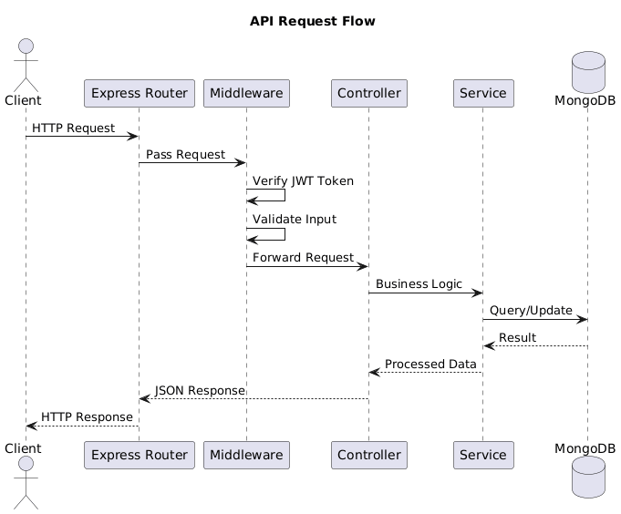
API Request Flow
Step-by-step flow
Client sends HTTP request (frontend/third-party).
Vercel Serverless Function receives request and invokes Express app.
Express Router matches route and forwards to middleware.
Auth / Validation Middleware (isLogin, isAdmin, validators`) — verifies JWT, validates input, short-circuits on error.
Controller extracts request data, handles request/response shape, calls service layer.
Service Layer (Business Logic) performs business rules, calls Mongoose models.
Mongoose Model executes query/update against MongoDB Atlas and returns results.
Service formats processed data → Controller sends JSON response → Vercel returns HTTP response to client.

Slide 19

04
Core Workflow Analysis

Slide 20
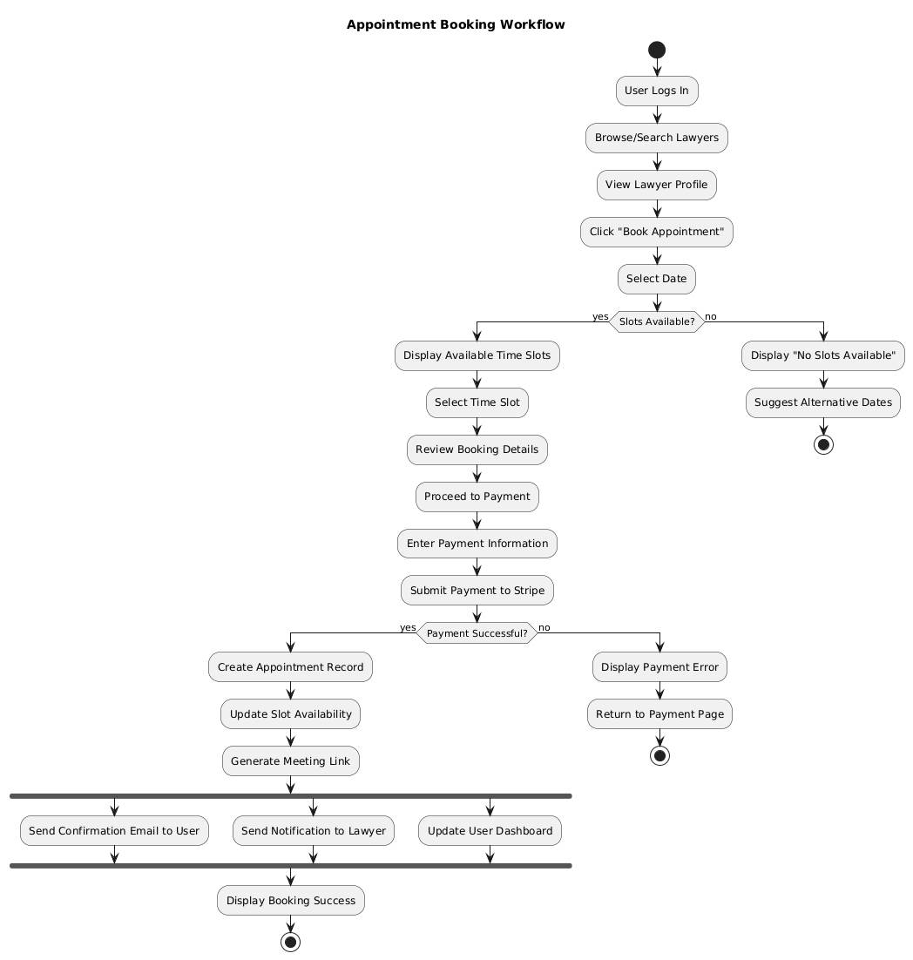
Appointment Booking
Step-by-step Process
User Browsing
User logs in
Searches/browses lawyers
Opens a lawyer’s profile
Clicks “Book Appointment”
Slot Selection
User selects a date
System checks slot availability
If slots exist → display time slots
If not → suggest alternative dates
Booking Review & Payment
User selects a time slot
Reviews appointment details
Proceeds to Stripe Checkout
Enters payment information
Stripe validates payment

Slide 21
Appointment Booking
Step-by-step Process
After Successful Payment
Appointment record is created
Slot availability is updated
A secure Jitsi meeting link is generated
User & Lawyer receive notifications
User dashboard updates automatically
Completion
Booking confirmation is displayed
User can now attend the meeting through the dashboard

Slide 22
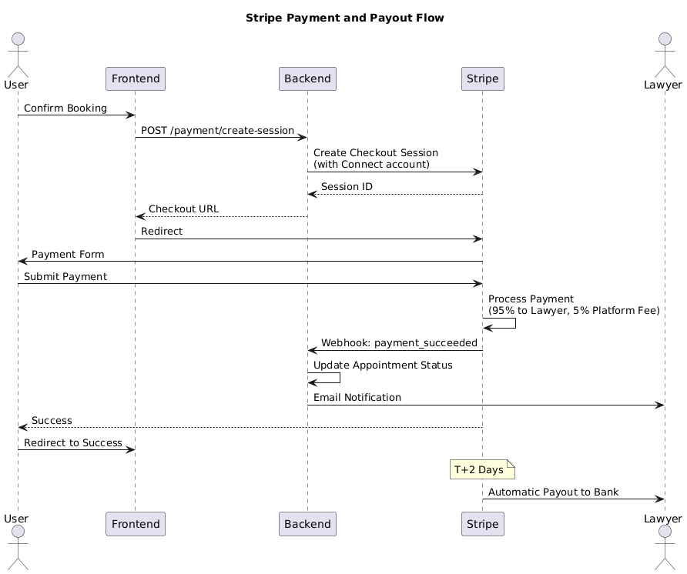
Stripe Payment Flow
Step-by-Step Payment & Payout Logic
User Initiates Payment
User confirms the booking on the frontend.
Frontend sends a request to backend: POST /payment/create-session
Backend Creates Stripe Checkout Session
Backend creates a Stripe Checkout Session linked to the lawyer’s Connect Account.
Stripe returns a Checkout URL, which is sent back to the frontend.
User is redirected to the Stripe payment page.
User Completes Payment on Stripe
User enters card details using Stripe’s secure form.
Stripe processes the payment and applies split payout:
95% → Lawyer
5% → Platform Fee

Slide 23
Stripe Payment Flow
Step-by-Step Payment & Payout Logic
Stripe Webhook Notification
Stripe sends a webhook event payment_succeeded to the backend.
Backend verifies the webhook and then:
Updates appointment status
Sends confirmation email
Generates and attaches the Jitsi meeting link
Success Redirect
User is redirected to a Success page on the frontend.

Slide 24

05
Deployment & Project Management
This Photo by Unknown Author is licensed under CC BY

Slide 25
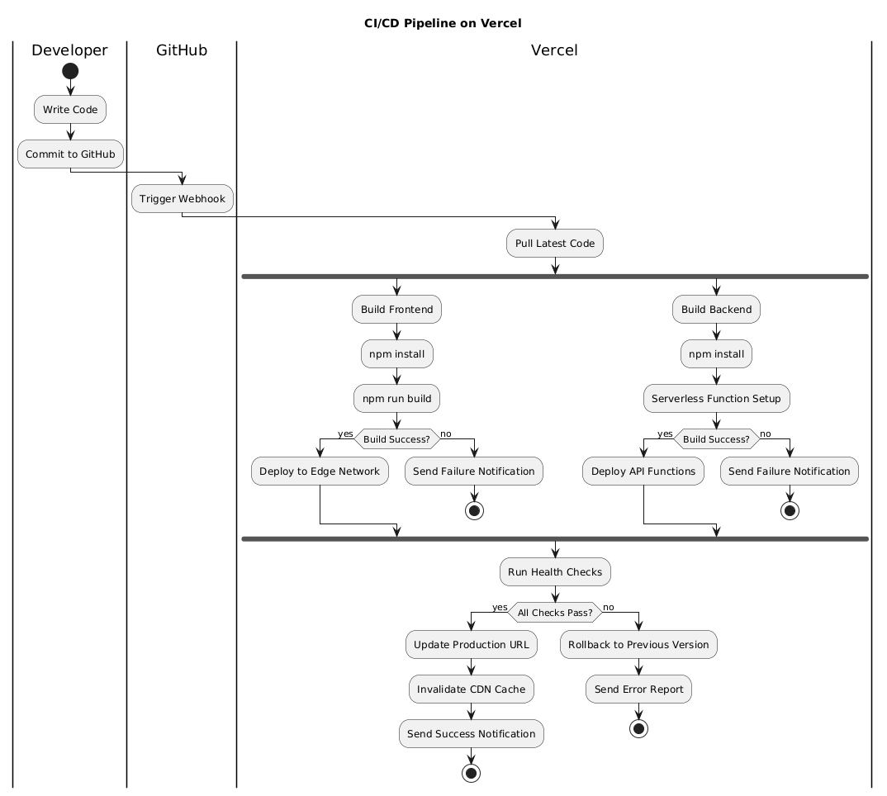
CI/CD Pipeline
Step-by-step Process
Developer pushes code to GitHub (monorepo).
GitHub webhook triggers Vercel build.
Vercel installs deps and builds /frontend (Vite) and /backend (serverless functions).
Successful builds → deploy frontend to edge CDN and backend as serverless APIs.
Run automated health checks and integration tests.
If checks pass → update production URL & invalidate CDN cache; if fail → rollback and alert.
Vercel handles preview deployments per PR; env vars and secrets managed in Vercel dashboard.
Scheduled jobs (slot updates, cleanup) run via Vercel Cron.

Slide 26
Automation: Cron Jobs
Scheduled backend tasks run daily (via Vercel Cron) to keep data consistent, free stale entries, and regenerate availability.
Runs as a secure Vercel Cron job (protected by CRON_SECRET).
Marks past appointments as completed when their timeslot ended.
Deletes expired time slots (unless booked) and removes old pending payments.
Generates new time slots from lawyer schedules (e.g., next 3 days).
Expires finished lawyer subscriptions and refreshes availableToday flags.
Cleans transient data (e.g., old contact messages) and logs the operation.
Includes error handling, idempotency, and logging for safe, repeatable runs.

Slide 27

06
Conclusion & Future Scope

Slide 28
Conclusion
CounselDesk successfully integrates legal services, AI assistance, secure payments, and video consultations into one unified platform.
The system streamlines the experience for users, lawyers, and admins, reducing friction in accessing legal help.
With a robust full-stack architecture, automated cron jobs, secure Stripe payouts, and Gemini-powered AI, the platform ensures reliability, scalability, and modern user experience.
This project demonstrates strong practical implementation of real-world technologies such as React, Node.js, MongoDB, Vercel Serverless, and third-party APIs.
CounselDesk lays a strong foundation for future enhancements like mobile apps, document automation, and AI-driven legal workflows.

Slide 29
Future Scope
AI Legal Drafting: Automated drafting of legal notices, agreements, and summaries using advanced Gemini models.
Real-Time Chat & Notifications: In-app chat between clients and lawyers with instant push notifications.
Advanced Analytics Dashboard: Detailed insights for lawyers and admins—earnings trends, client engagement, performance metrics.
Document Automation & E-Signatures: Upload, fill, sign, and store legal documents securely.
Multi-Language Support: Regional language support for wider accessibility across India.
Expanded Legal Code Database: Full normative, state laws, and case-law search powered by AI.
Integration with Government APIs: e-Courts, DigiLocker, and Bar Council verification for trusted onboarding.

Slide 30
References
Brown, E., Web Development with Node and Express: Leveraging the JavaScript Stack, 2nd ed. O'Reilly Media, 2019.​
Banks, A. and Porcello, E., Learning React: Modern Patterns for Developing React Apps, 2nd ed. O'Reilly Media, 2020.​
Sommerville, I., Software Engineering, 10th ed. Pearson Education, 2016.​
Pressman, R. S. and Maxim, B. R., Software Engineering: A Practitioner's Approach, 9th ed. McGraw-Hill Education, 2020.​
Fowler, M., Patterns of Enterprise Application Architecture. Addison-Wesley Professional, 2002.​
Susskind, R., Online Courts and the Future of Justice. Oxford University Press, 2019.​
Newman, S., Building Microservices: Designing Fine-Grained Systems, 2nd ed. O'Reilly Media, 2021.​
Alarie, B., Niblett, A., and Yoon, A. H., "How Artificial Intelligence Will Affect the Practice of Law," University of Toronto Law Journal, vol. 68, no. 1, pp. 106-124, 2018.​
Surden, H., "Machine Learning and Law," Washington Law Review, vol. 89, no. 1, pp. 87-115, 2014.​
Remus, D. and Levy, F. S., "Can Robots Be Lawyers? Computers, Lawyers, and the Practice of Law," Georgetown Journal of Legal Ethics, vol. 30, no. 3, pp. 501-558, 2017.​

Slide 31

Live Demo & Links
Live Project:
https://counsel-desk.vercel.app
GitHub Code:
https://github.com/Aayush6377/CounselDesk
Scan to open the Live Project

Slide 32

THANK YOU
Do you have any questions?

